Slide 1
Metabolism of Amino acids
General and specific metabolic reactions of amino acids_Transamination

Slide 2
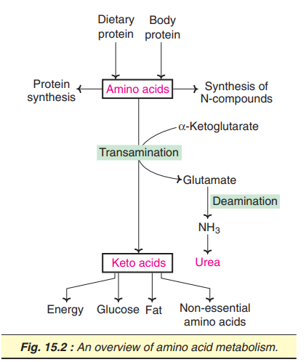

Slide 3
general and specific metabolic reactions of amino acids
TRANSAMINATION
  The transfer of an amino (-NH2) group from an amino acid to a keto acid
  transaminases

Slide 4
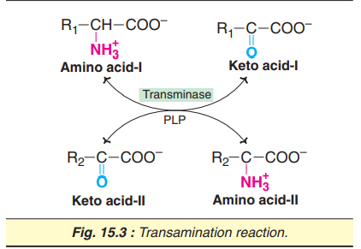
Salient features of transamination
All transaminases require pyridoxal phosphate (PLP), a coenzyme derived from vitamin B6

Slide 5
. Specific transaminases exist for each pair of amino and keto acids. However, only two— namely,
  aspartate transaminase and
  alanine transaminase—make a significant contribution for transamination

Slide 6
There is no free NH₃ liberated, only the transfer of amino group occurs.
Transamination is reversible

Slide 7
. Transamination is very important for the
    redistribution of amino groups and
    production of non-essential amino acids, as per the requirement of the cell.
    It involves both catabolism (degradation) and anabolism (synthesis) of amino acids.

Slide 8
Transamination diverts the excess amino acids towards energy generation

Slide 9
The amino acids undergo transamination to finally concentrate nitrogen in glutamate.
Glutamate is the only amino acid that undergoes oxidative deamination to a significant extent to liberate free NH₃ for urea synthesis.

Slide 10
All amino acids except lysine, threonine, proline and hydroxyproline participate in transamination.
Transamination is not restricted to α -amino groups only. For instance, δ -amino group of ornithine is transaminated.

Slide 11
Mechanism of transamination
1. Transfer of the amino group to the coenzyme pyridoxal phosphate (bound to the coenzyme) to form pyridoxamine phosphate.
2. The amino group of pyridoxamine phosphate is then transferred to a keto acid to produce a new amino acid and the enzyme with PLP is regenerated.

Slide 12
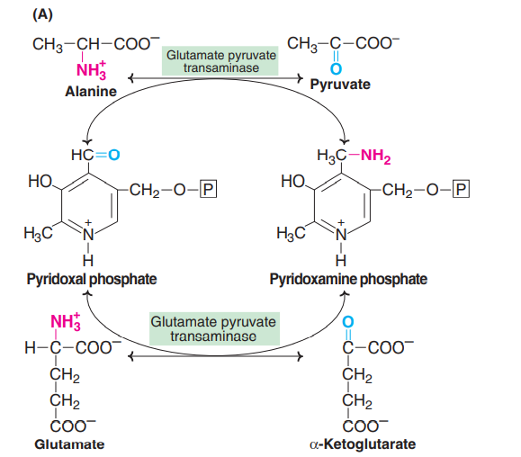

Slide 13
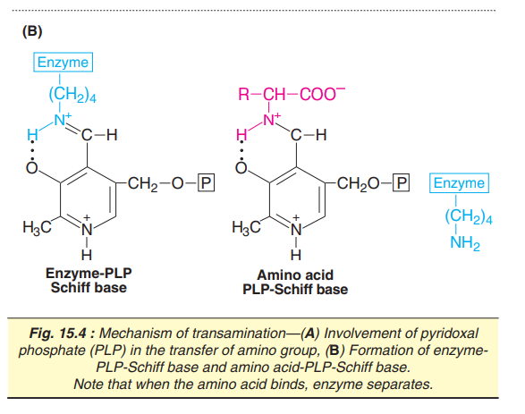

Slide 14
All the transaminases require pyridoxal phosphate (PLP), a derivative of vitamin B6.
The aldehyde group of PLP is linked with ε-amino group of lysine residue, at the active site of the enzyme forming a Schiff base (imine linkage).
When an amino acid (substrate) comes in contact with the enzyme, it displaces lysine and a new Schiff base linkage is formed.
The amino acid-PLP-Schiff base tightly binds with the enzyme by noncovalent forces.

Slide 15
REFERENCE:
Biochemistry ; 4th Edition; Elserivier
Dr. U. Satyanarayana Dr. U. Chakrapan

