Slide 1
ANGIOSPERM ANATOMY

Slide 2
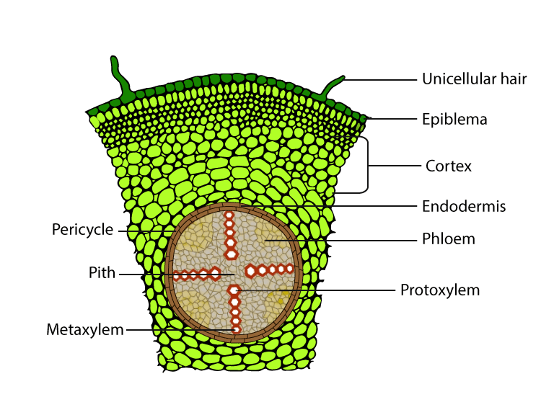
Primary structure of Dicot root
https://images.app.goo.gl/hQBQLpSiwy6UiyvGA

Slide 3
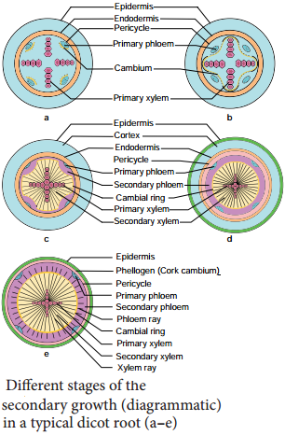
Secondary growth in Dicot root
https://images.app.goo.gl/XKK5mMPw3HXyKKJF9

Slide 4
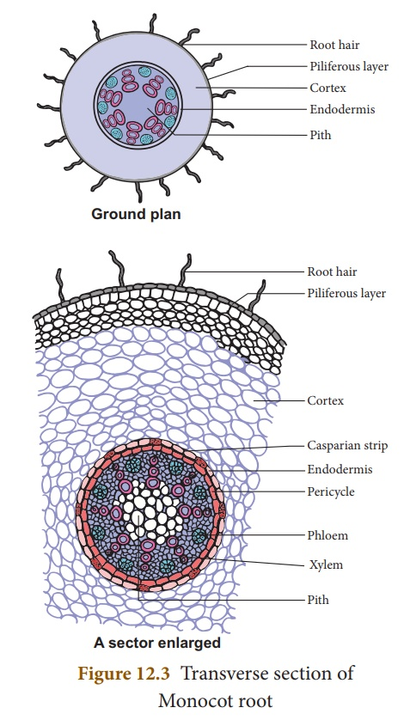
https://images.app.goo.gl/eFvvtwTZdp1kQn2a9

Slide 5
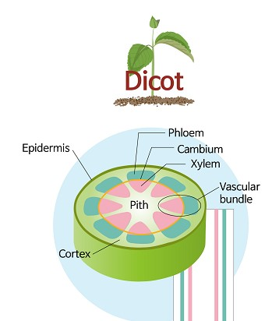
https://www.yaclass.in/p/science-state-board/class-10/plant-anatomy-physiology-9477/plant-anatomy-9461/re-ca0afebb-2381-4b21-a06c-644e2b90d050

Slide 6
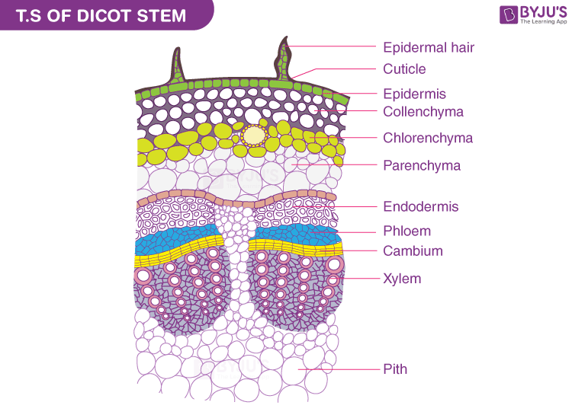
https://images.app.goo.gl/wbPW9sGKMj8hNMUw5

Slide 7
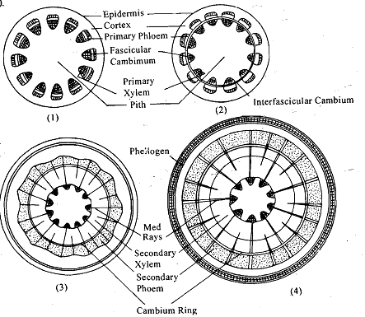
https://images.app.goo.gl/ipo6EbV14RiuRNTGA

Slide 8
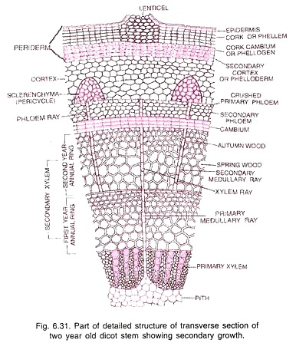
https://www.biologydiscussion.com/stems-2/dicot-stem/secondary-growth-in-dicot-stem-with-diagram/70397

Slide 9
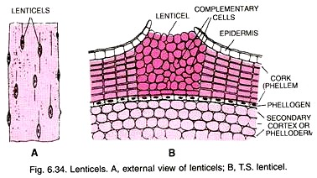
https://www.biologydiscussion.com/stems-2/dicot-stem/secondary-growth-in-dicot-stem-with-diagram/70397

Slide 10
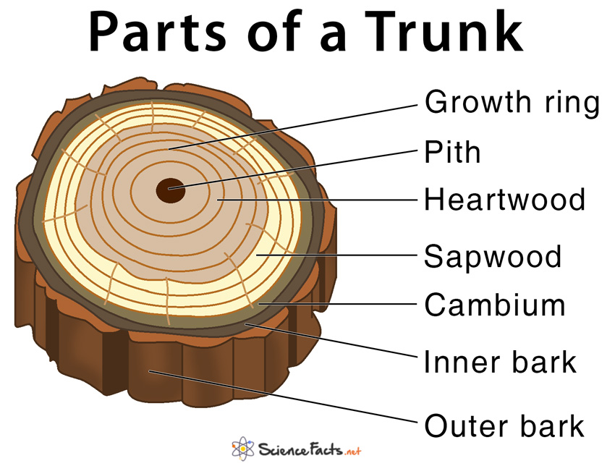
https://images.app.goo.gl/urrvqJMkyiditU697

