Slide 1
MODES OF REPLICATION

Slide 2
THREE MODELS FOR DNA REPLICATION
There were three basic models for DNA replication that had been proposed by the scientific community after the discovery of DNA's structure. These models are illustrated in the diagram below:
Semi-conservative replication. In this model, the two strands of DNA unwind from each other, and each acts as a template for synthesis of a new, complementary strand. This results in two DNA molecules with one original strand and one new strand.
Conservative replication. In this model, DNA replication results in one molecule that consists of both original DNA strands (identical to the original DNA molecule) and another molecule that consists of two new strands (with exactly the same sequences as the original molecule).
Dispersive replication. In the dispersive model, DNA replication results in two DNA molecules that are mixtures, or “hybrids,” of parental and daughter DNA. In this model, each individual strand is a patchwork of original and new DNA.
Matt Meselson and Franklin Stahl originally met in the summer of 1954, the year after Watson and Crick published their paper on the structure of DNA. Although the two researchers had different research interests, they became intrigued by the question of DNA replication and decided to team up and take a crack at determining the replication mechanism

Slide 3
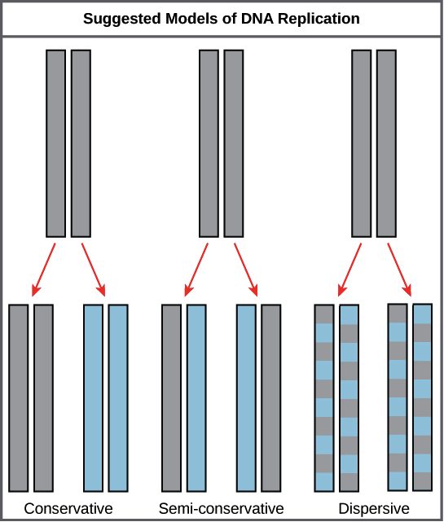
THREE MODELS FOR DNA REPLICATION

Slide 4
THE MESELSON-STAHL EXPERIMENT
Meselson and Stahl conducted their famous experiments on DNA replication using E. coli bacteria as a model system.
Meselson and Stahl conducted their famous experiments on DNA replication using E. coli bacteria as a model system.
They began by growing E. coli in medium, or nutrient broth, containing a "heavy" isotope of nitrogen, ¹⁵N. (An isotope is just a version of an element that differs from other versions by the number of neutrons in its nucleus.) When grown on medium containing heavy ¹⁵N, the bacteria took up the nitrogen and used it to synthesize new biological molecules, including DNA.
After many generations growing in the ¹⁵N medium, the nitrogenous bases of the bacteria's DNA were all labeled with heavy ¹⁵N. Then, the bacteria were switched to medium containing a "light" ¹⁴N isotope and allowed to grow for several generations. DNA made after the switch would have to be made up of ¹⁴N, as this would have been the only nitrogen available for DNA synthesis.

Slide 5
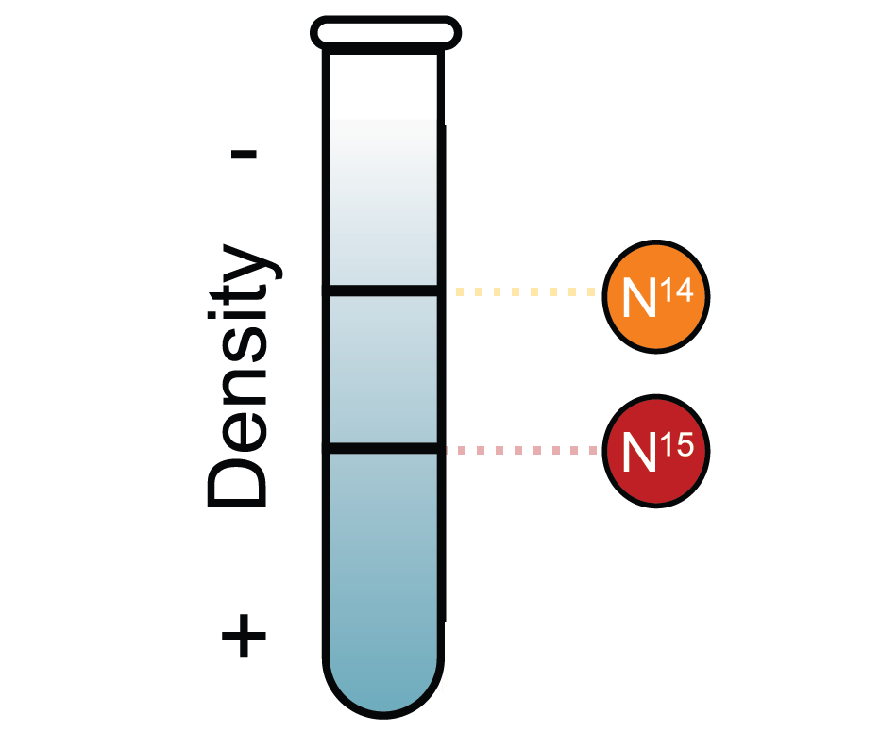
THE MESELSON-STAHL EXPERIMENT
Meselson and Stahl knew how often E. coli cells divided, so they were able to collect small samples in each generation and extract and purify the DNA. They then measured the density of the DNA (and, indirectly, its ¹⁵N and ¹⁴N content) using density gradient centrifugation.
This method separates molecules such as DNA into bands by spinning them at high speeds in the presence of another molecule, such as cesium chloride, that forms a density gradient from the top to the bottom of the spinning tube. Density gradient centrifugation allows very small differences—like those between ¹⁵N - and ¹⁴N -labeled DNA—to be detected.

Slide 6
RESULTS OF THE EXPERIMENT
When DNA from the first four generations of E. coli was analyzed, it produced the pattern of bands shown in the figure below:
Generation 0
DNA isolated from cells at the start of the experiment (“generation 0,” just before the switch to ¹⁴N medium) produced a single band after centrifugation. This result made sense because the DNA should have contained only heavy ¹⁵N at that time.
Generation 1
DNA isolated after one generation (one round of DNA replication) also produced a single band when centrifuged. However, this band was higher, intermediate in density between the heavy ¹⁵N DNA and the light ¹⁴N DNA.
The intermediate band told Meselson and Stahl that the DNA molecules made in the first round of replication was a hybrid of light and heavy DNA. This result fit with the dispersive and semi-conservative models, but not with the conservative model.
The conservative model would have predicted two distinct bands in this generation (a band for the heavy original molecule and a band for the light, newly made molecule).

Slide 7
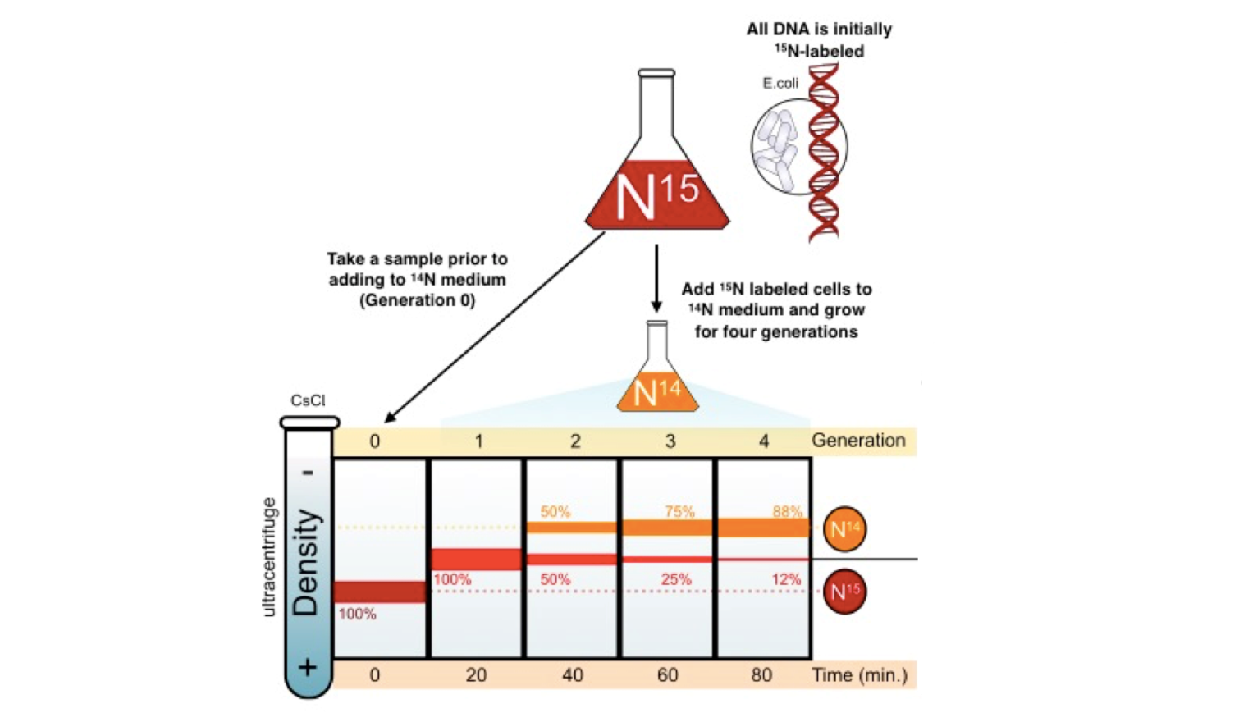
RESULTS OF THE EXPERIMENT

Slide 8
RESULTS OF THE EXPERIMENT
Generation 2
Information from the second generation let Meselson and Stahl determine which of the remaining models (semi-conservative or dispersive) was actually correct.
When second-generation DNA was centrifuged, it produced two bands. One was in the same position as the intermediate band from the first generation, while the second was higher (appeared to be labeled only with ¹⁴N).
This result told Meselson and Stahl that the DNA was being replicated semi-conservatively. The pattern of two distinct bands—one at the position of a hybrid molecule and one at the position of a light molecule—is just what we'd expect for semi-conservative replication (as illustrated in the diagram below). In contrast, in dispersive replication, all the molecules should have bits of old and new DNA, making it impossible to get a "purely light" molecule.

Slide 9
RESULTS OF THE EXPERIMENT
Generations 3 and 4
In the semi-conservative model, each hybrid DNA molecule from the second generation would be expected to give rise to a hybrid molecule and a light molecule in the third generation, while each light DNA molecule would only yield more light molecules.
Thus, over the third and fourth generations, we'd expect the hybrid band to become progressively fainter (because it would represent a smaller fraction of the total DNA) and the light band to become progressively stronger (because it would represent a larger fraction).
As we can see in the figure, Meselson and Stahl saw just this pattern in their results, confirming a semi-conservative replication model.

Slide 10
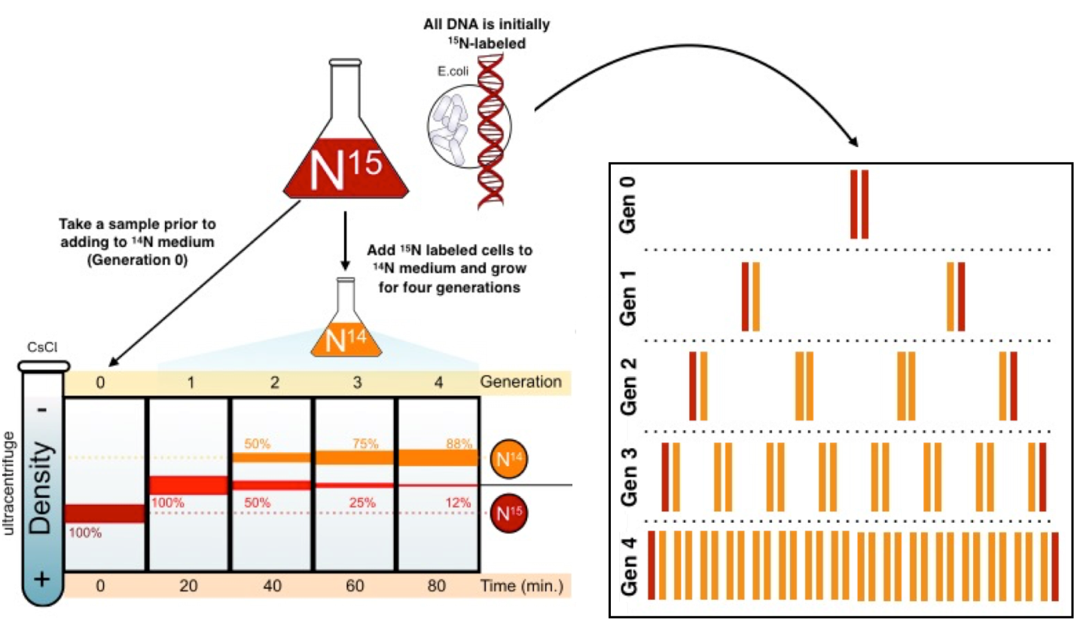
RESULTS OF THE EXPERIMENT

Slide 11
CONCLUSION
The experiment done by Meselson and Stahl demonstrated that DNA replicated semi-conservatively, meaning that each strand in a DNA molecule serves as a template for synthesis of a new, complementary strand.
Although Meselson and Stahl did their experiments in the bacterium E. coli, we know today that semi-conservative DNA replication is a universal mechanism shared by all organisms on planet Earth. Some of your cells are replicating their DNA semi-conservatively right now!

