Slide 1
VERBENACEAE

Slide 2
Systematic position
Class – Dicotyledonae
  Subclass – Gamopetalae
    Series – Bicarpellatae
      Order – Lamiales
        Family – Verbenaceae

Slide 3
DISTRIBUTION
Verbenaceae or the verbena family includes about 98 genera and nearly 2614 species, widely dispersed in nearly all warm and temperate region.

Slide 4
FAMILIAR PLANTS

Slide 5
???

Slide 6
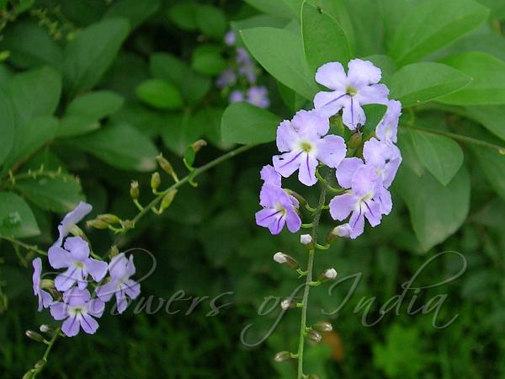
Duranta repens
Golden dew drop / Common hedge

Slide 7
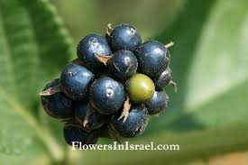
???

Slide 8
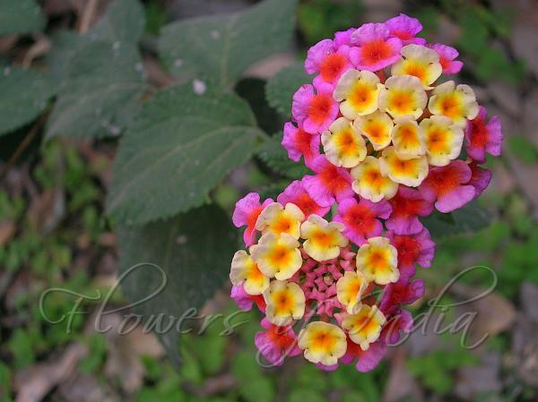
Lantana camara
Lantana

Slide 9
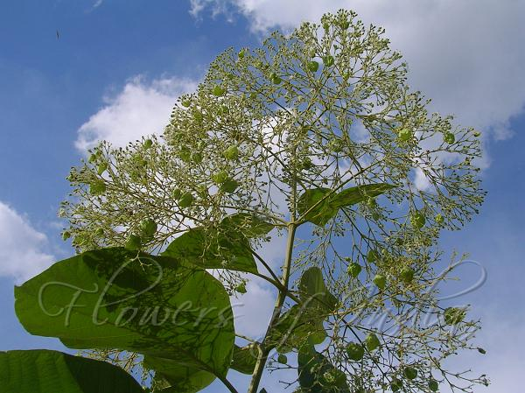
???

Slide 10
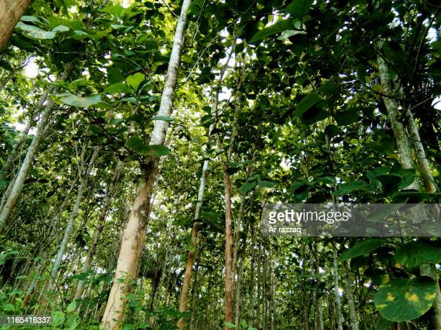
Tectona grandis
Teak

Slide 11
???

Slide 12
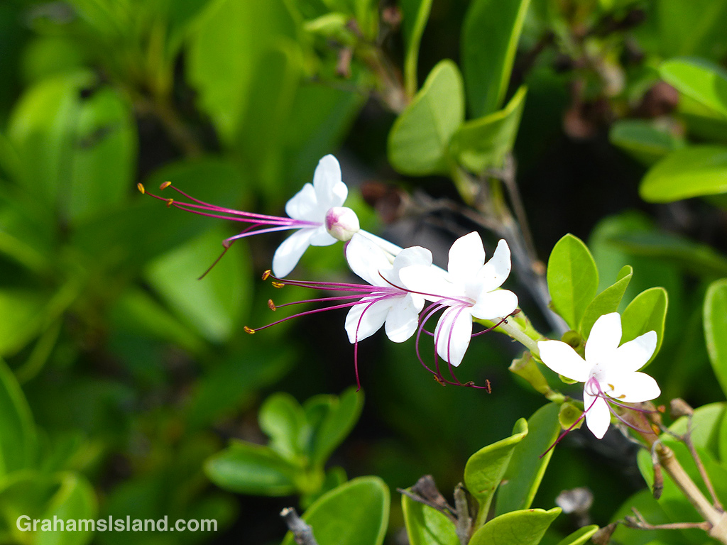
Clerodendron inerme
Kundali gida/Vishama dhari/Wild Jasmine

Slide 13
???

Slide 14
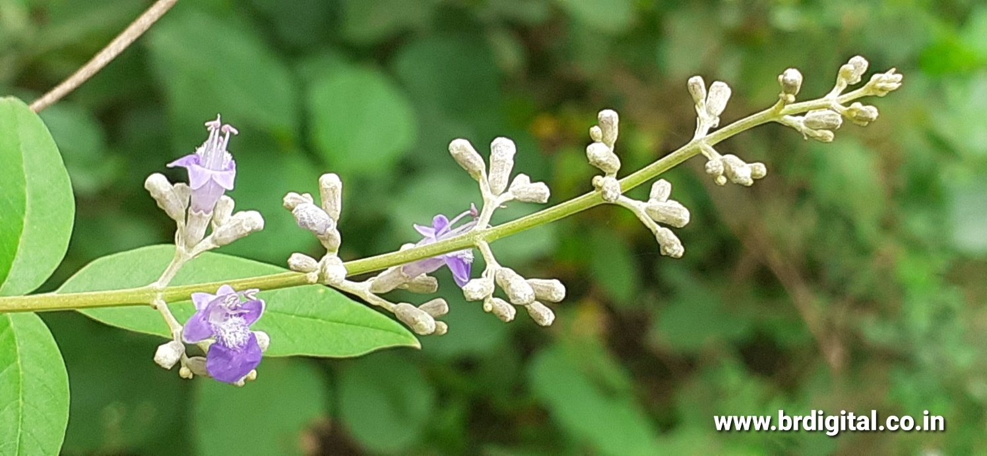
Vitex negundo
Chinese Chastetree/Nirgundi

Slide 15
VEGETATIVE CHARACTERS

Slide 16
HABITAT
Generally mesophytes, rarely halophytes (Avicennia officinalis)

Slide 17
HABIT
Shrubs or trees (Tectona), Rarely herbs (Lippia nodiflora) or climbers (Petrea).

Slide 18
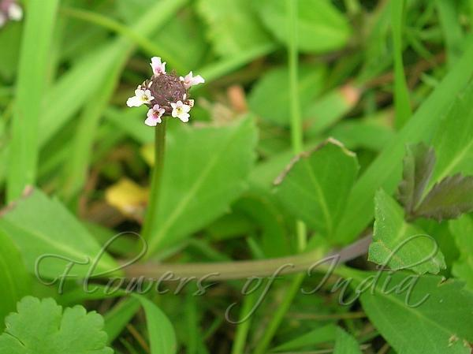
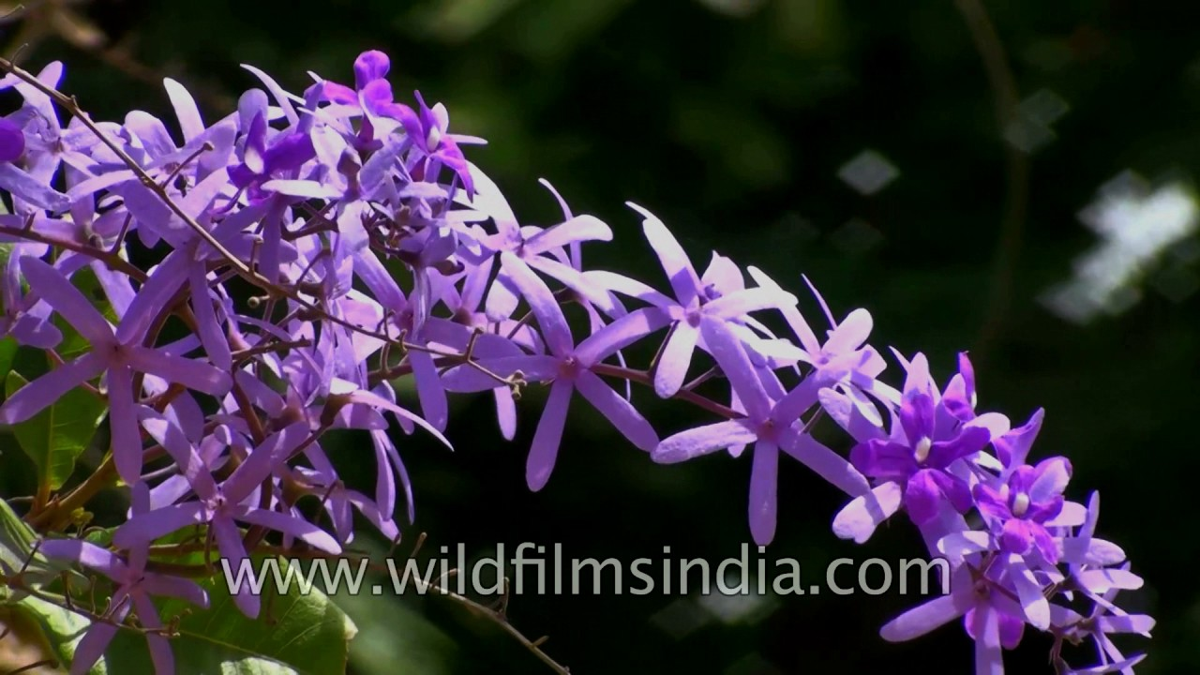

Slide 19
ROOT
Tap root and branched.

Slide 20
STEM
Erect, herbaceous or woody, young branches quadrangular, in some branches spiny.

Slide 21
LEAF
Simple or palmately or pinnately (Peronema , Vitex) compound, opposite (Stachytarpheta indica) or whorled, exstipulate, entire or divided.

Slide 22
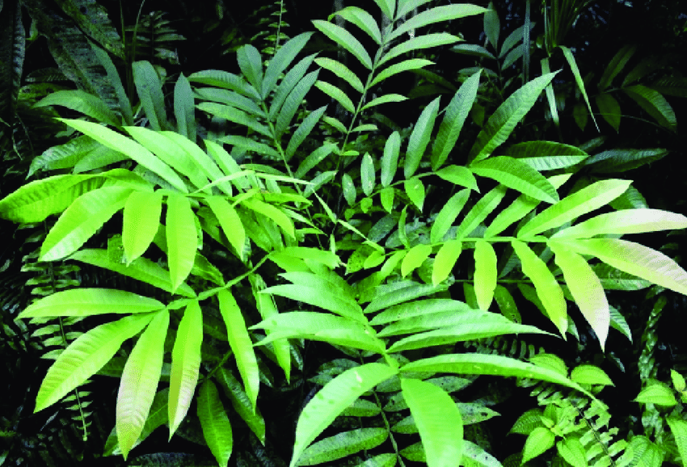
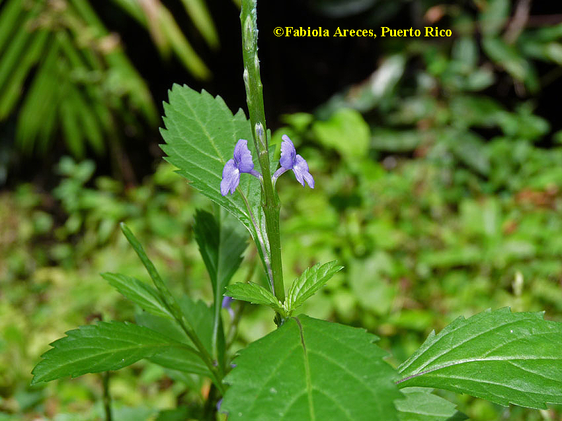

Slide 23
REPRODUCTIVE CHARACTERS

Slide 24
INFLORESCENCE
Cyme or racemose spikes often with an involucre of coloured bracts, often compound or paniculate; cymose is usually dichasial (Clerodendron).

Slide 25
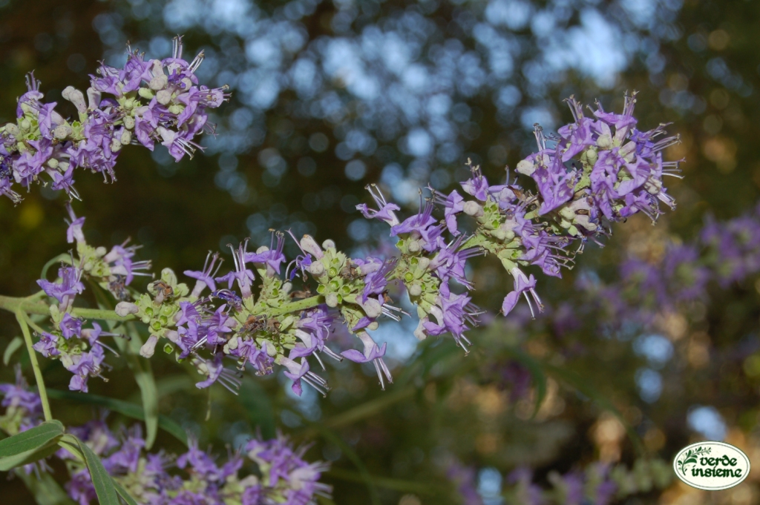

Slide 26
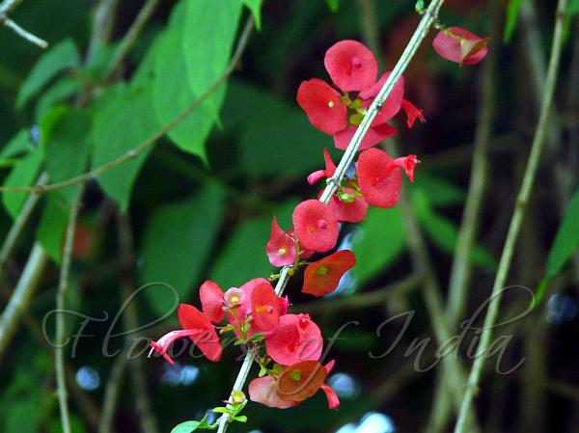

Slide 27
FLOWERS
Zygomorphic, hermaphrodite, rarely unisexual by abortion (Aegiphila), hypogynous, pentamerous or tetramerous (Physopsis), rarely actinomorphic (Physopsis) complete.

Slide 28
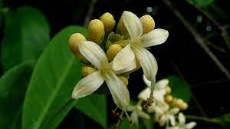
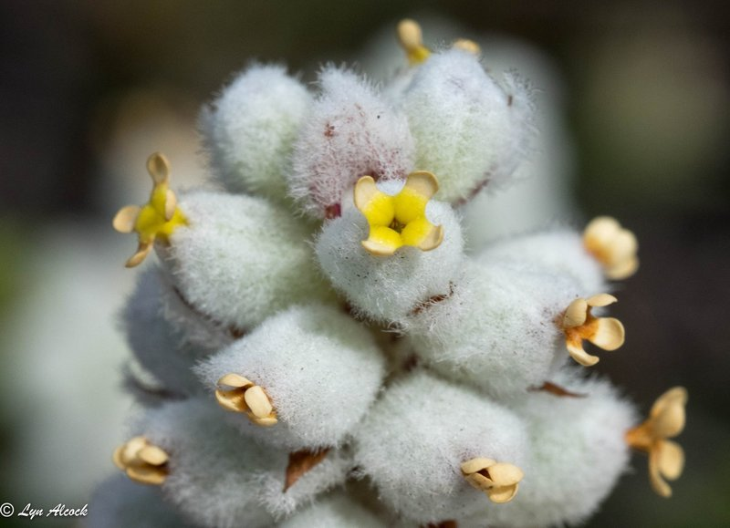

Slide 29
CALYX
Sepals 5 lobed, gamosepalous, persistent, bell shaped or tubular, rarely 4 to 8 valvate.

Slide 30
COROLLA
Petals 5 or 4 lobed, gamopetalous petals unequal, tubular or cylindrical, bi-lipped, imbricate.

Slide 31
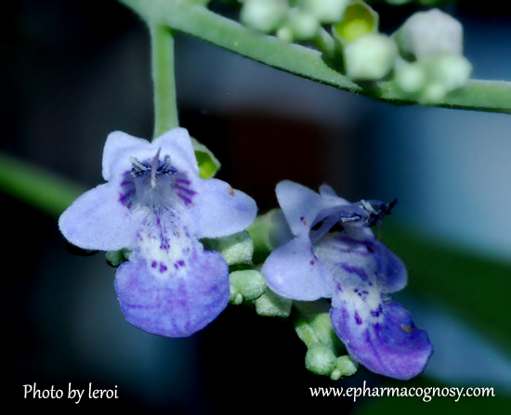

Slide 32
ANDROECIUM
Stamens 4, didynamous, fifth stamen may be staminode or absent rarely 5 present (Tectona), epipetalous, bithecous, filaments free, dorsifixed, introrse, dehiscence longitudinal.

Slide 33
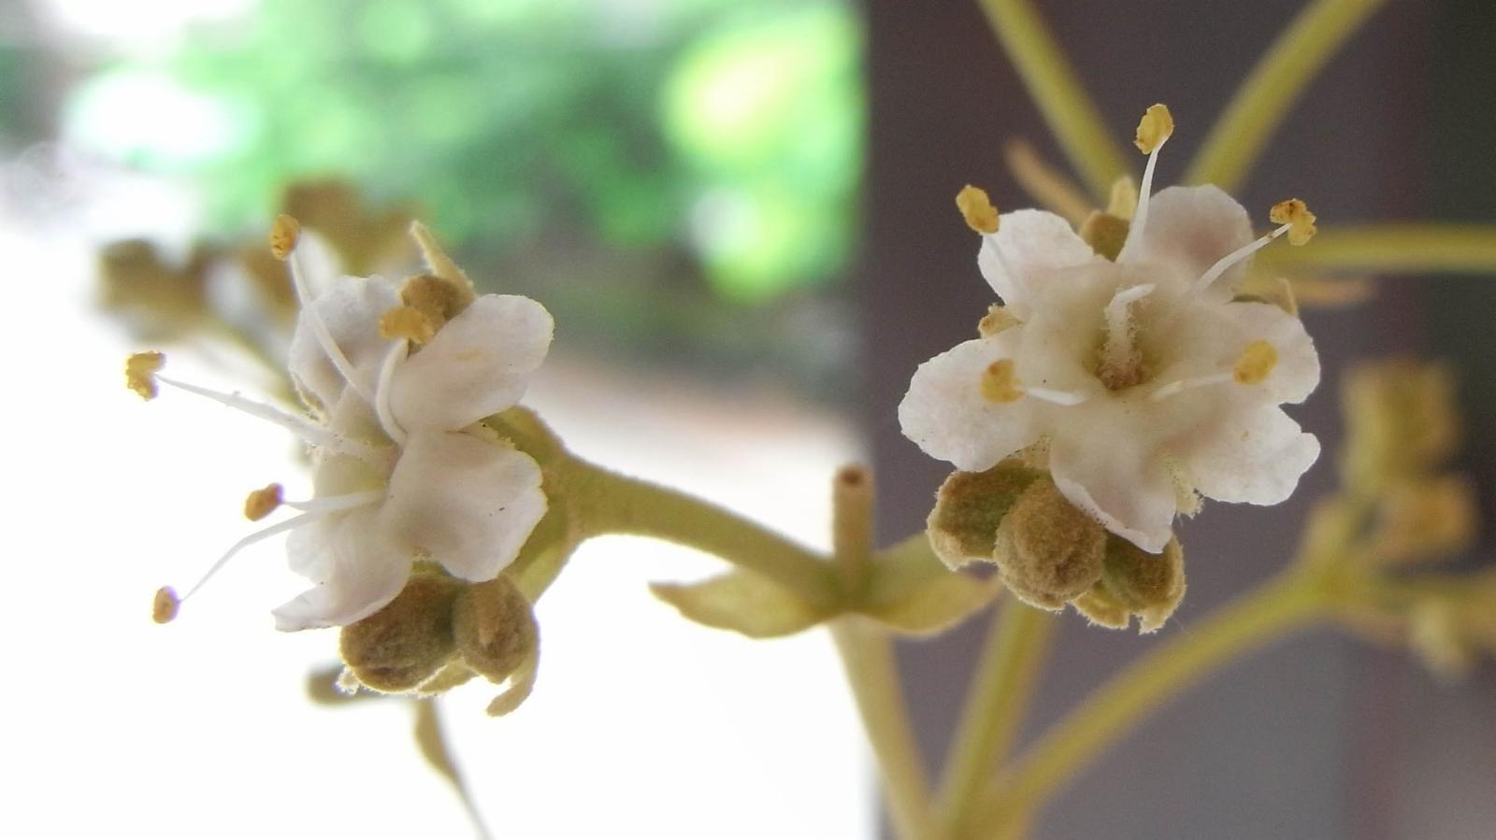

Slide 34
GYNOECIUM
Bicarpellary, syncarpous, rarely carpels 4 (Duranta) or 5 (Geunsia) superior in early stage bilocular but soon divided into 4 or many loculed by false septa, axile placentation or free central in Avicennia; style terminal, stigma entire or bilobed.

Slide 35
Fruit:
Drupe rarely schizocarpic capsule enclosed by persistent calyx (Glandularis spp.).
Seed:
Non-endospermic with a straight embryo.
Pollination:
Entomophilous.

Slide 36
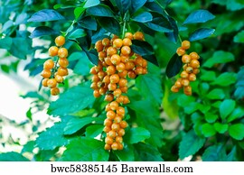

Slide 37
IMPORTANT GENERA

Slide 38
Verbena: Verbena officinalis – Perennial herb.
Lippia: Lippia nodiflora – Perennial herb.
Duranta: Duranta plumieri –Common hedge plant.
Clerodendron: Clerodendron inerme – A seashore plant

Slide 39
Callicarpa: Callicarpa macrophylla
Avicennia: Avicennia officinalis – mangrove shrub
Tectona: Tectona grandis – Deciduous tree
Premna: Premna cariacea – Strong smelling climber – yeild fuel and produce fire by friction (Himalayas)

Slide 40
Phryma: Phryma leptostachya
Holmskioldia: Holmskioldia sanguinea
Caryopteris: Caryopteris wallchiana
Lantana: Lantana camara – Invasive alien species.
Vitex: Vitex negundo

Slide 41
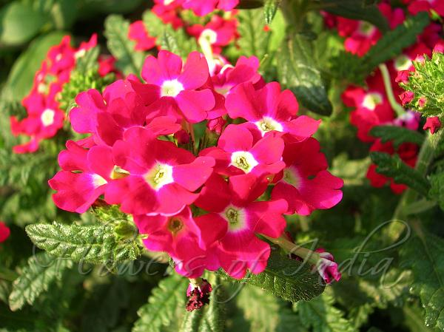
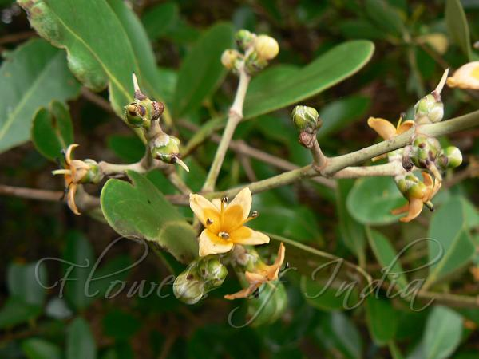
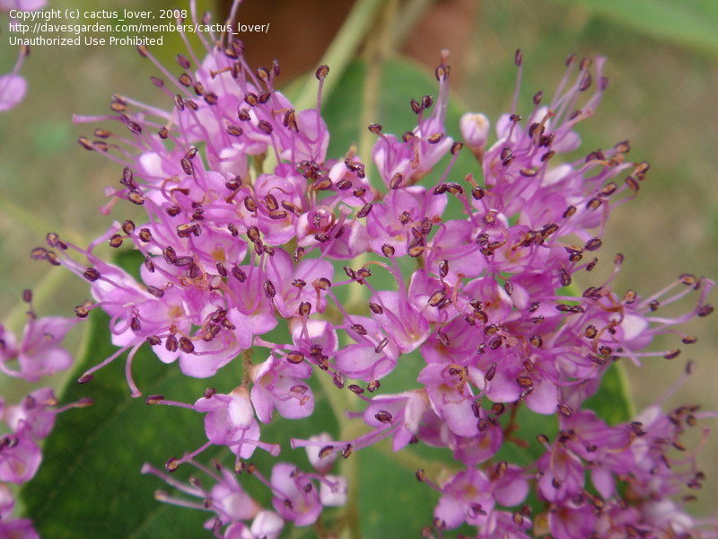
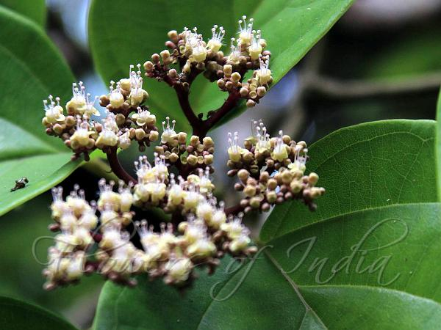

Slide 42
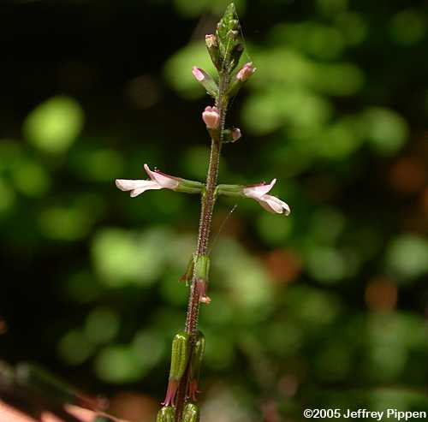
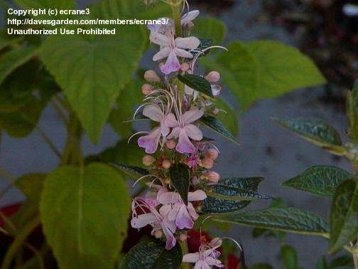

Slide 43
ECONOMIC IMPORTANCE
1. Timber:
The wood of Tectona grandis (Teak, H. Sagwan) is extremely hard and lasting. The wood is largely used in manufacturing of ships and good quality furniture. Teak is grown in forests of Burma, Madhya Pradesh and Assam. The wood of Gmelina arborea is used in making drums, sitars and other musical instruments.

Slide 44
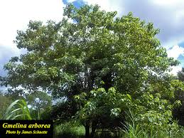

Slide 45
2. Medicinal:
The roots of Clerodendron are used in asthma and cough. The decoction of leaves of Lantana camara is given in tetanus and rheumatism. The leave’s juice of Gmelina arborea is used in gonorrhoea, cough and ulcers.
3. Oils:
Lippia alba produces a valuable oil.

Slide 46
4. Tanning:
The bark of Avicennia is used in tanning.
5. Febrifuge:
The leaves of Vitex negundo serve as febrifuge. The branches of this plant are kept over stored grains to keep off insects.
6. Ornamental:
Lantana, Verbena officinalis, Duranta, Congea tomentosa, Callicarpa, Clerodendron, Petrea are cultivated in gardens.

Slide 47
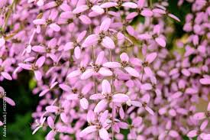
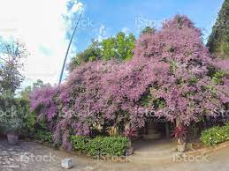

Slide 48
AFFINITY
The family shows close relationship with Lamiaceae (Labiatae) in the bilabiate corolla, persistent calyx. It also bears some affinity with Boraginaceae in the nature of inflorescence, calyx and fruit. It bears relationship with Acanthaceae.

Slide 49
Bentham and Hooker included the family Verbenaceae in the Lamiales. Hallier retained Verbenaceae within Tubiflorae and sought its origin from the Scrophulariaceae. Hutchinson at first (1926) accepted it as belonging to his Lamiales, but later (1948, 1959) segregated it as the Verbenales and derived it from rubiaceous stocks.

Slide 50
Hutchinson (1969) in “Families of Flowering plants” treated Stibaceae, Chloranthaceae and Phrymataceae as separate families, which were tribes of Verbenaeae in Bentham and Hooker’s Genera plantarum. Thus the family is reduced to include five tribes only.

Slide 51
DISTINGUISHING CHARACTERS
Plants herbs, shrubs or trees
Leaves simple, usually exstipulate, opposite or whorled; sometimes pinnately or palmately compound.
Inflorescence variable; cymose, raceme or spike.
Flowers bisexual; zygomorphic, hypogynous;
Calyx 4-5 persistant.

Slide 52
Corolla 4-5 lobed, gamopetalous, sometimes bilipped.
Stamens 4, didynamous, epipetalous.
Carpels 2, syncarpous, superior.
Fruit drupaceous – nutlets
Seed exalbuminous.

Slide 53
References
Kuswantoro, F. (2017). Traditional Anti Malaria Plants Species of Balikpapan Botanic Garden, East Kalimantan-Indonesia. KnE Life Sciences, 78-85.
https://species.wikimedia.org/wiki/Aegiphila
https://davesgarden.com/guides/pf/showimage/435631/

