Slide 1
Ultra structure of Prokaryotic and Eukaryotic Cell

Slide 2
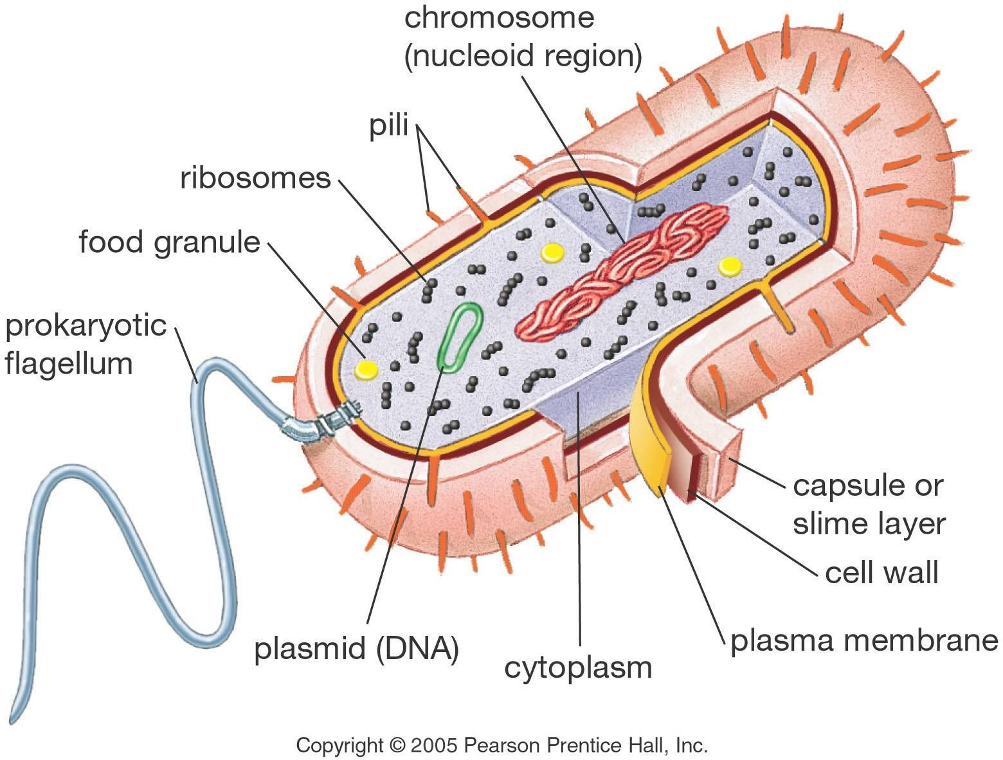
Ultra-structure of Prokaryotic Cell

Slide 3
The ultrastructure of a prokaryotic cell is a typical bacterial cell consists of cell envelope, cytoplasm, nucleoid, plasmids and surface appendage.
1. Cell envelope:
It is the protective covering of bacterial cell that has three basic layers:
The outermost glvcocalyx, middle cell wall and innermost cell membrane (plasma membrane).

Slide 4
Glycocalyx:
It is the outermost layer of cell envelope which is chemically composed of polysaccharides.When it is thick and tough, it is called capsule, and when it forms a loose sheath it is called slime layer.
(a) Protects cell from desiccation, toxins and phagocytes.
(b) Helps in adhesion, immunogenicity and virulence.

Slide 5
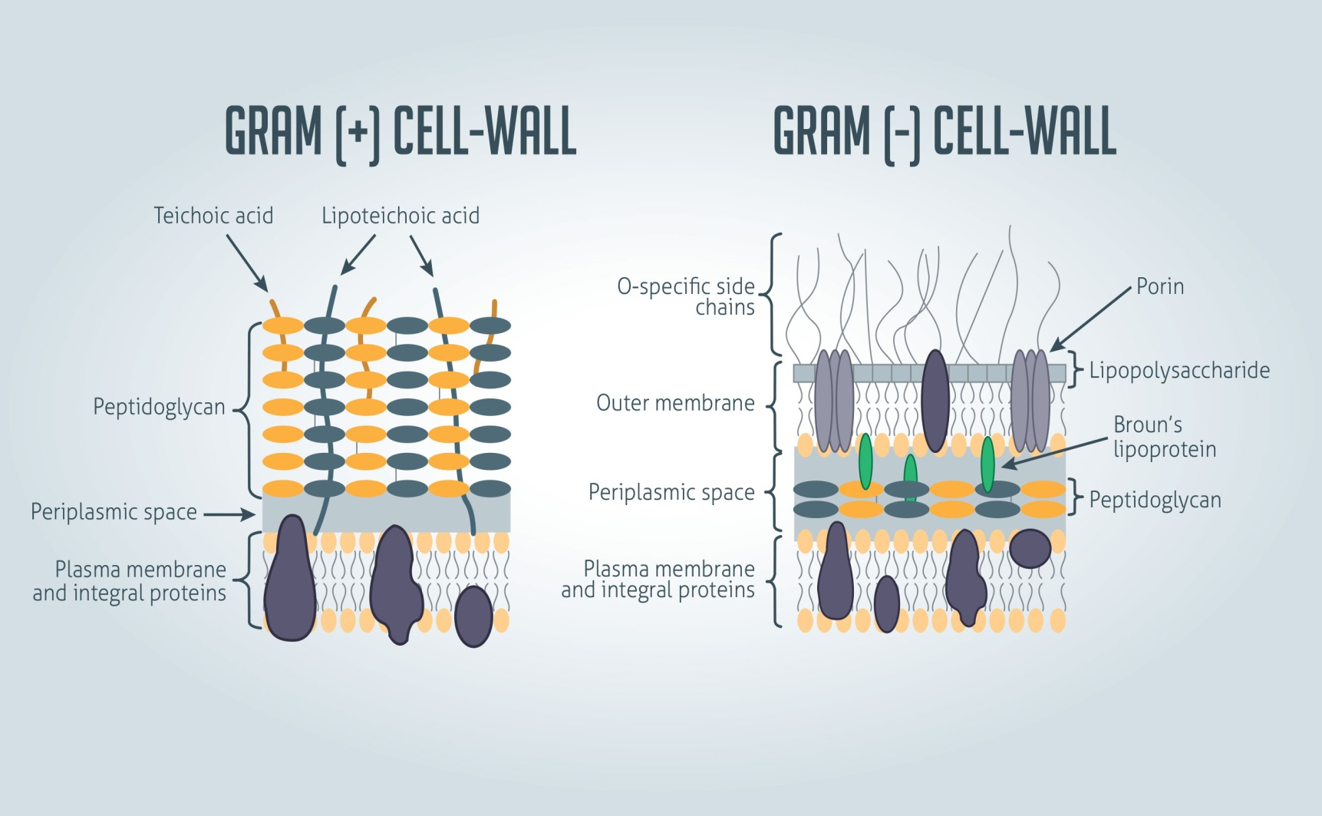
Cell Wall
https://images.app.goo.gl/DV7nTqT72AWG3zBs6

Slide 6
It is the innermost layer of cell envelope. It is a semi-permeable, similar to that of eukaryotic membrane.
But the only difference is they lack sterols instead hopanoids present.
The hopanoids are pentacyclic sterol-like molecules that stabilize the bacterial cell membrane.

Slide 7
In a bacterial cell, plasma membrane performs many functions:
It retains the cytoplasm
Prevent loss of essential components through leakage
Aids in the movement of nutrients, wastes and secretions across the membrane
Holds receptor molecules that detect and respond chemicals in their surroundings. Such as respiration, photosynthesis, synthesis of lipids and cell wall constituents
It invaginates to form mesosome and thylakoids of cyanobacteria.

Slide 8
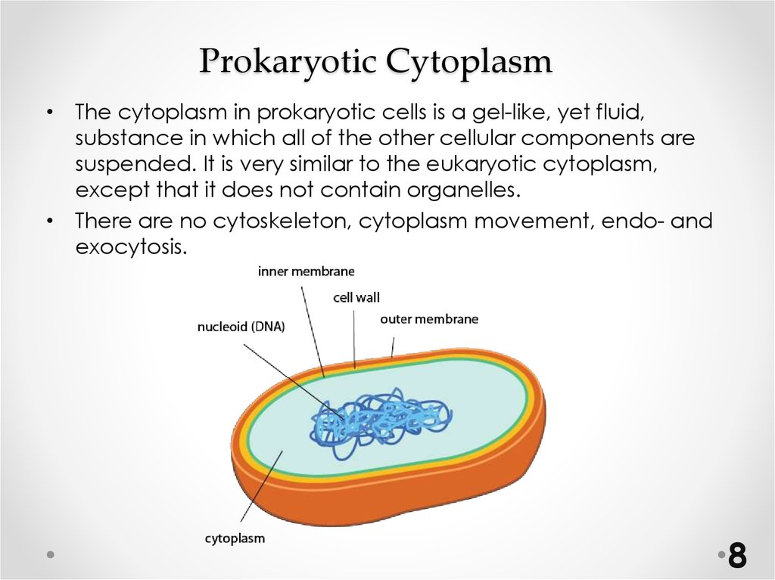
https://images.app.goo.gl/JiPdGA3p1PmaXLeb6

Slide 9
(i) Mesosome (or chondrioids):
It is membranous infolding of the plasma membrane.
Mesosome when connected with nucleoid is called septal mesosome and when not connected called lateral mesosome.
They help in Cell wall formation, chromosome replication and distribution to daughter cells, secretory activity.
(ii) Chromatophores:
These are internal membrane systems of prokaryotic cells. In nitrifying bacteria the chromatophores increase metabolic area.
(iii) Ribosomes:
Prokaryotic ribosomes are 70S in nature that consist of larger 5OS and smaller 30S subunits. During protein synthesis, about 4-8 ribosomes attach to a single mRNA to form polyribosomes or polysomes. Non functional ribosomes present in separated subunits.
(iv) Inclusion bodies:These are non-living structures present freely in the cytoplasm. Inclusion bodies may be organic or inorganic.

Slide 10
Food reserve:
These are reserve materials or storage granules which are not bounded by any membrane system.
The volutin granules (= polyphosphate granules) and sulphur granules are inorganic inclusion bodies which store phosphate and sulphur respectively.
These granules are also called meta-chromatic granules because of their ability to take different colours to basic dyes.
The organic- food reserves present in some bacteria are glycogen granules, protein granules, and starch.

Slide 11
Carboxysomes: These are principal sites of CO₂ fixation in case of autotrophic prokaryotes like cyanobacteria, purple bacteria, nitrifying bacteria
Magnetosomes:
These are the vesicles filled with crystals of magnetite (Fe₃O₄). Magneto-somes help the bacteria to orient themselves in a magnetic field and determine the direction of swimming.
Plasmids:
Laderberg and Hays (1952) introduced the term ‘plasmid’ to those ring-like self replicating extra chromosomal double stranded DNA that are found in the cytoplasm of prokaryotes.

Slide 12
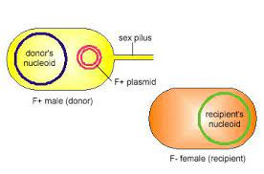
Sex plasmid:
It carries fertility factor (F-factor) responsible for the formation of sex-pili and conjugation. Hence, often called F-plasmid.
R-Plasmid:
It carries resistance (R) factor which provide resistance against antibiotics, heavy metals, UV-radiation etc., e.g. Rl.R4G etc.
https://images.app.goo.gl/543JTG1JJnLku5MG6

Slide 13
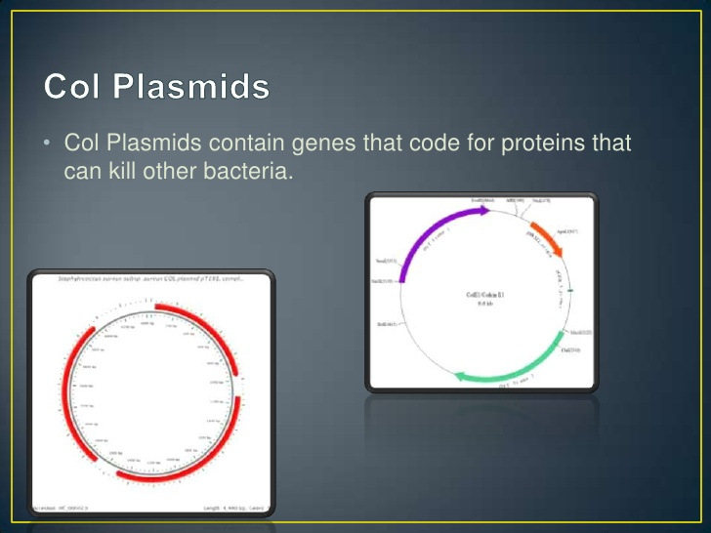
https://images.app.goo.gl/fVfbX9JJcn8n2JBa8

Slide 14
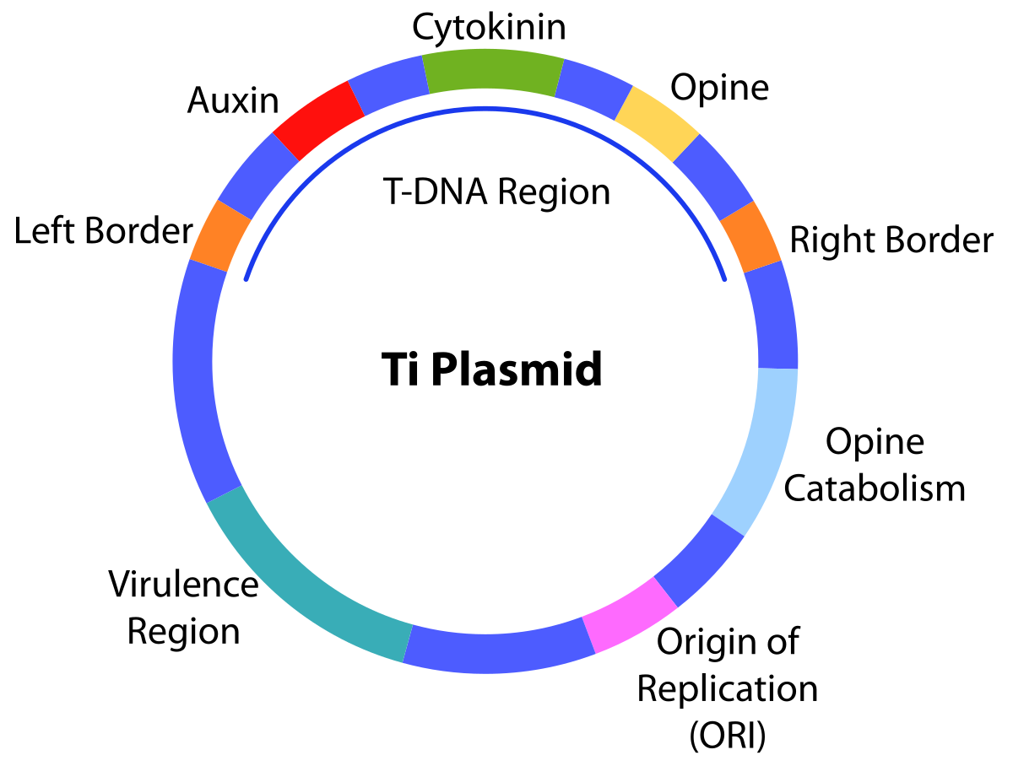
Ti-plasmids:
These are tumour including plasmids carried by the Agrabacterium tumefaciens.
https://images.app.goo.gl/5QEGvYQSuqUPgY2bA

Slide 15
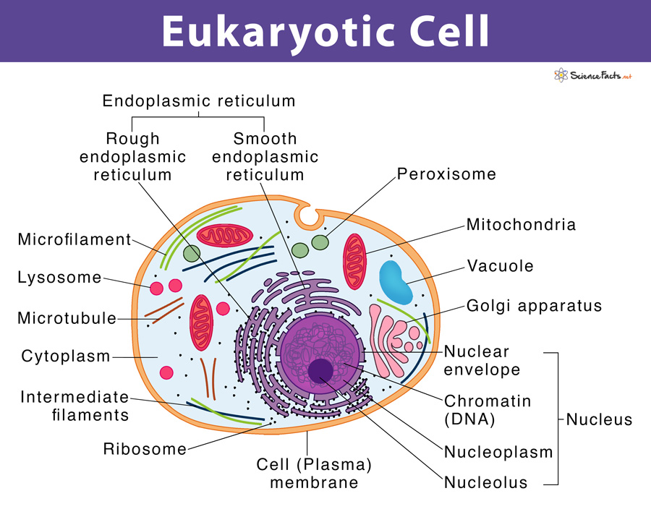
https://images.app.goo.gl/J1zGTkPVENzDs5Lj9

Slide 16
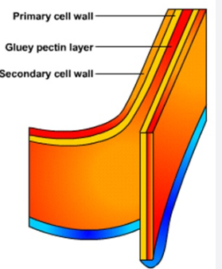
Cell Wall
Middle lamella – It is the outermost layer and is made of calcium pectates. It holds adjoining cells together.
Primary wall – It is the middle layer and is made of cellulose and hemicellulose. It is present in young, growing cells and is capable of growth.
Secondary wall – It is the innermost layer and similar in composition to the primary wall.
https://images.app.goo.gl/pTgY2xKnLjJk9rhZ8

Slide 17
Cytoplasmic Membrane
It is also called plasma membrane or cell membrane. The plasma membrane is a semi-permeable membrane that separates the inside of a cell from the outside.
In eukaryotic cells, the plasma membrane consists of proteins, carbohydrates and two layers of phospholipids (i.e. lipid with a phosphate group).
The polar, hydrophilic (water-loving) heads face the outside and inside of the cell. These heads interact with the aqueous environment outside and within a cell.
The non-polar, hydrophobic (water-repelling) tails are sandwiched between the heads and are protected from the aqueous environments.

Slide 18
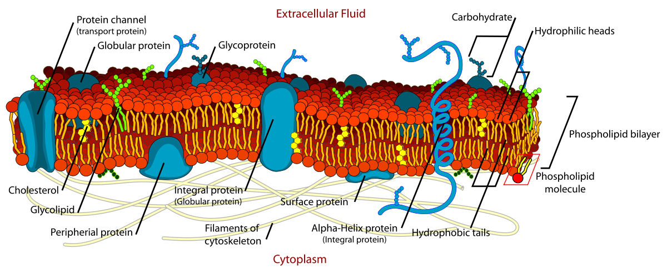
Scientists Singer and Nicolson described the structure of the phospholipid bilayer as the ‘Fluid Mosaic Model’. It looks like a mosaic and has a semi-fluid nature that allows lateral movement of proteins within the bilayer.
https://images.app.goo.gl/Vx6V2mV4hnurCWPPA

Slide 19
Functions
The plasma membrane is selectively permeable i.e. it allows only selected substances to pass through.
It protects the cells from shock and injuries.
The fluid nature of the membrane allows the interaction of molecules within the membrane. It is also important for secretion, cell growth, and division etc..

Slide 20
It allows transport of molecules across the membrane. This transport can be of two types:
  Active transport – This transport occurs against the concentration gradient and therefore, requires energy. It also needs carrier proteins and is a highly selective process.
  Passive transport – This transport occurs along the concentration gradient and therefore, does not require energy. Thus, it does not need carrier proteins and is not selective.

Slide 21
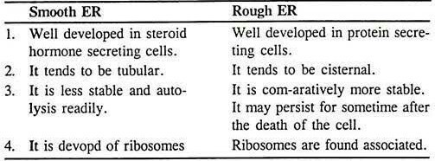
https://images.app.goo.gl/FXkN3cWLZyjCraZz5

Slide 22
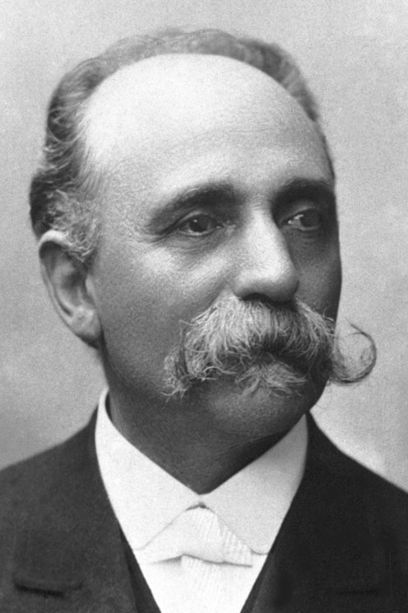
Golgi Apparatus
It is named after the scientist who discovered it, Camillo Golgi.
Golgi is made of many flat, disc-shaped structures called cisternae.
It is present in all eukaryotic cells except human red blood cells and sieve cells of plants.
https://images.app.goo.gl/yAYwowdXwS9KUVfM7

Slide 23
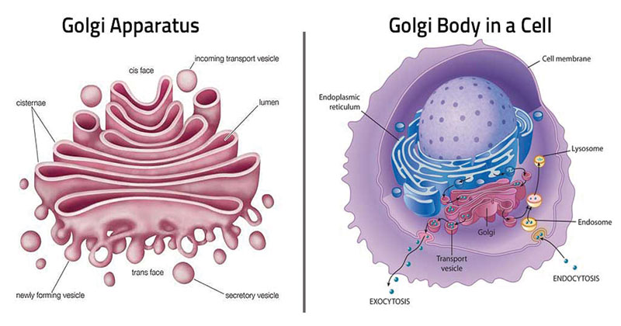
Structure
The cisternae are arranged in parallel and concentrically near the nucleus as follows:
Cis face (forming face) – It faces the plasma membrane and receives secreted material in vesicles.
Trans face (maturing face) – It faces the nucleus and releases the received material into the cell.
https://images.app.goo.gl/k9Z1qoRaJHsNASqQA

Slide 24
Functions
An important site for packaging material within the cell.
Proteins are modified in the Golgi.
An important site for the formation of glycolipids (i.e. lipids with carbohydrate) and glycoproteins (i.e. proteins with carbohydrates).

Slide 25
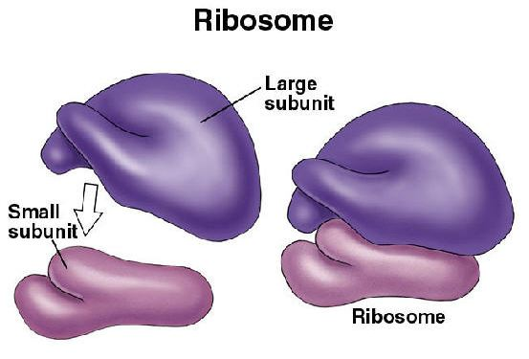
Ribosome Structure
These structures are not bound by a membrane. Ribosomes are also called ‘Protein factories’ since they are the main site of protein synthesis.
They are made of ribonucleic acids and proteins. Eukaryotic ribosomes are of the 80S type, with 60S (large subunit) and 40S (small subunit).
https://images.app.goo.gl/2Hn9rQwrH2EMA2m37

Slide 26
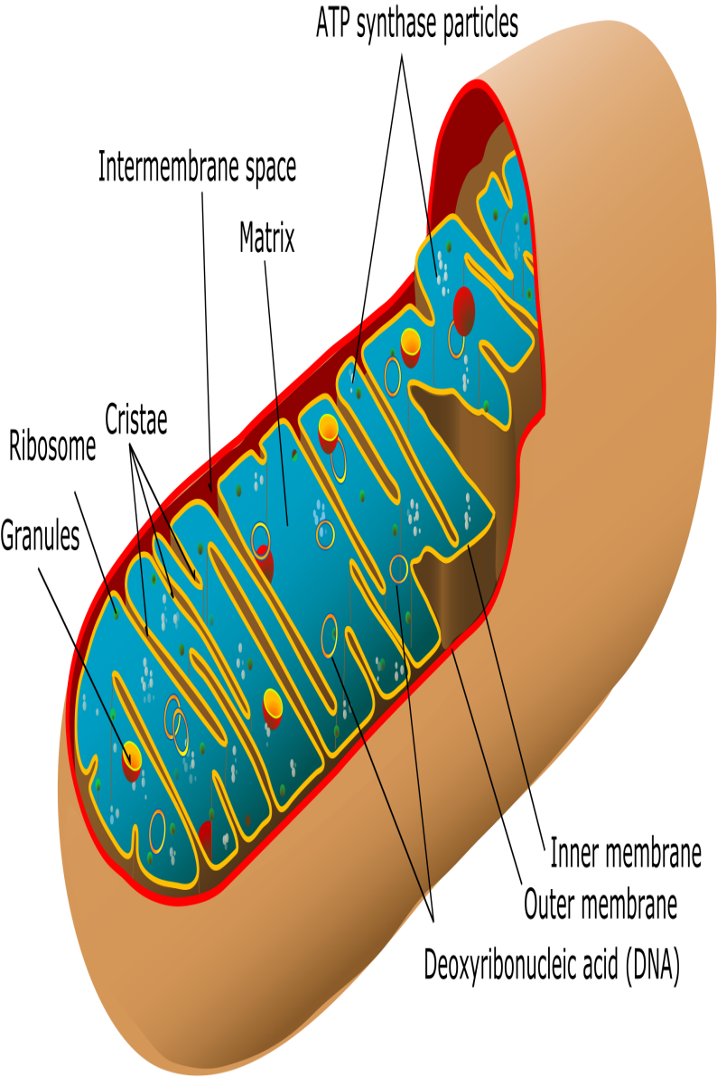
Mitochondria Structure
They are membrane-bound organelles- ‘powerhouses of the cell’.
The outer membrane forms a continuous boundary around the mitochondria.
The inner membrane is semi-permeable and divided into folds called ‘cristae’.
The membranes divide the lumen -into an inner and outer compartment.
The inner compartment is called matrix and outer compartment forms the intermembrane space.

Slide 27
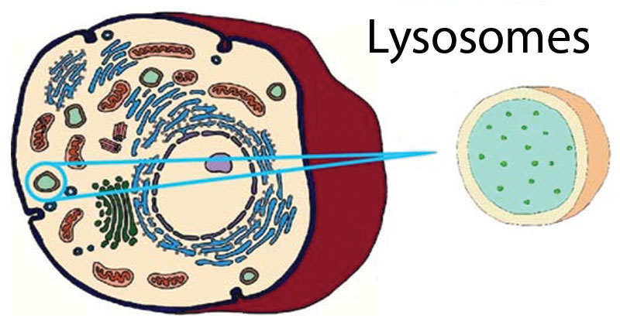
Lysosome Structure
They are membrane-bound vesicles formed in the Golgi apparatus.
Lysosomes are called ‘suicidal bags’ since they are rich in hydrolytic enzymes such as lipases, proteases, carbohydrates etc.
These enzymes are optimally active at acidic pH
(less than 7).

Slide 28
Nucleus Structure
Nucleus is the main organelle of a cell.
It is a double membrane structure with all the genetic information.
Therefore, it is also called the ‘brain’ of a cell.
The nucleus is found in all eukaryotic cells except human RBCs and sieve cells of plants.

Slide 29
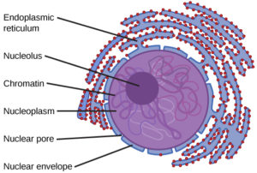
Nuclear envelope – It is a double membrane that surrounds the nucleus, outer membrane is continuous with ER. The inner membrane has small pores called ‘nuclear pores’.
Nucleoplasm – It is the fluid material in the nucleus that contains the nucleolus and chromatin.
Nucleolus –sites for ribosomal RNA synthesis.
Chromatin – It consists of DNA and proteins called ‘histones’.
The DNA is organised into chromosomes.
https://images.app.goo.gl/e4w427nWpb1GP6bA8

Slide 30
References
Verma, P. S., & Agarwal, V. K. (2004). Cell Biology, Genetics, Molecular Biology, Evolution and Ecology: Evoloution and Ecology. S. Chand Publishing.
https://www.biologydiscussion.com/eukaryotic-cell/difference-between-prokaryotic-and-eukaryotic-cells/35107
https://www.biologydiscussion.com/cytology/2-main-types-of-cell-cytology/83449
https://byjus.com/biology/prokaryotic-and-eukaryotic-cells/

