Slide 1
Data Modeling Using the Entity-Relationship Model
Using High-Level Conceptual Data Models for Database Design
Or
What are the phases of a database design

Slide 2
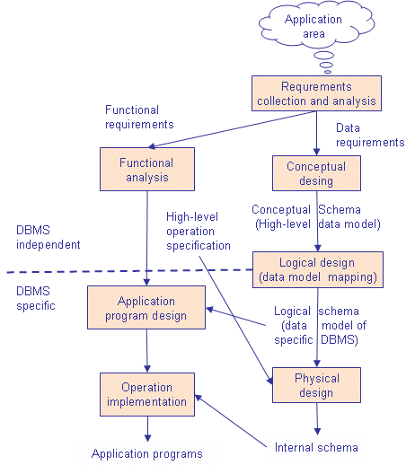

Slide 3
What is an Entity Relationship Diagram (ER Diagram)?
An ER diagram shows the relationship among entity sets. An entity set is a group of similar entities and these entities can have attributes. In terms of DBMS, an entity is a table or attribute of a table in database, so by showing relationship among tables and their attributes, ER diagram shows the complete logical structure of a database.

Slide 4
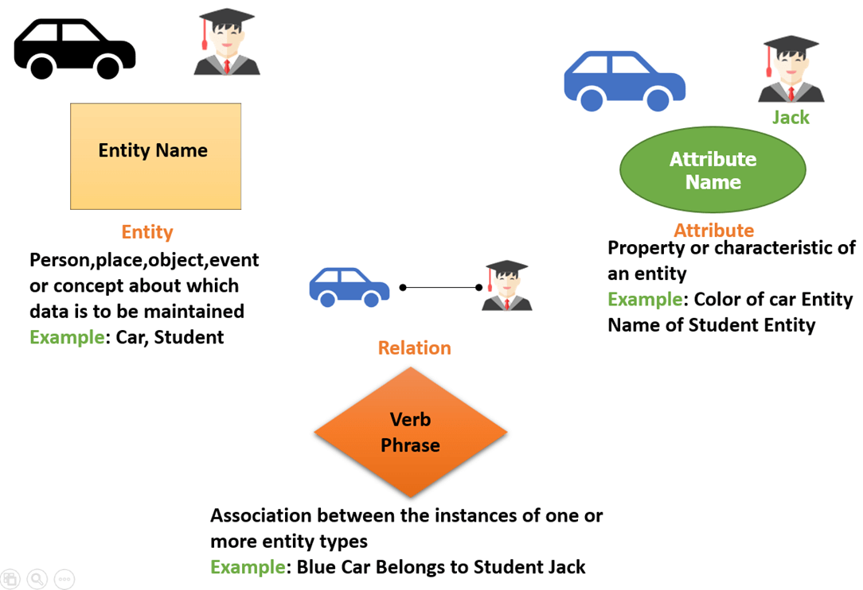

Slide 5
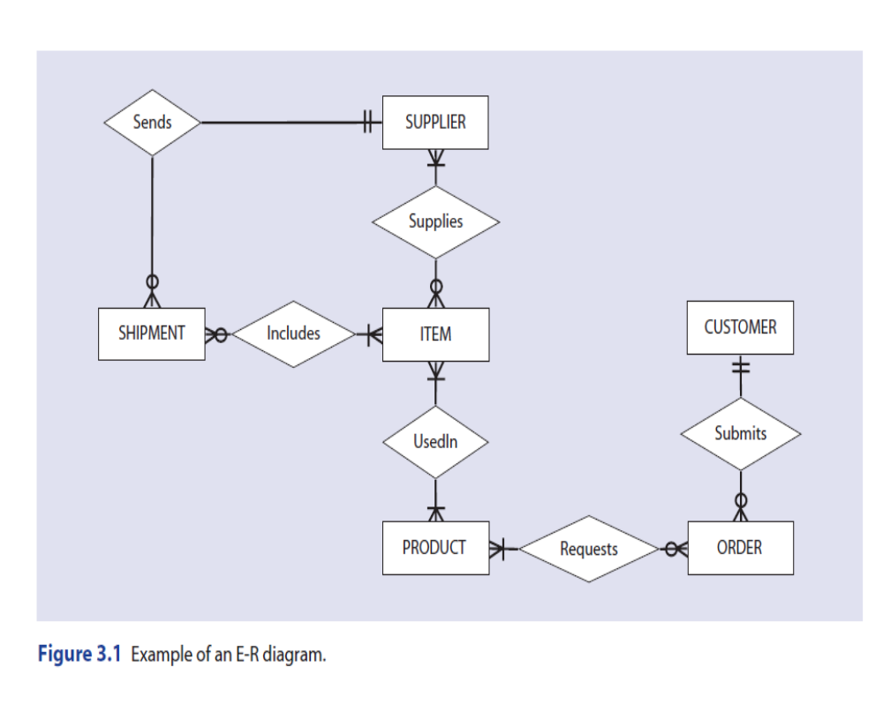

Slide 6
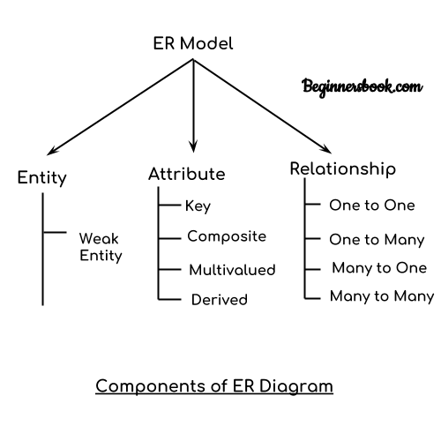

Slide 7

Entity
An entity is an object or component of data. An entity is represented as rectangle in an ER diagram.
For example: In the following ER diagram we have two entities Student and College.

Slide 8
Attribute AND Relationship
An attribute describes the property of an entity. An attribute is represented as Oval in an ER diagram.
A relationship is represented by diamond shape in ER diagram, it shows the relationship among entities.

Slide 9
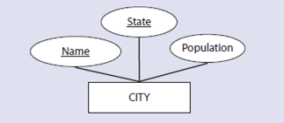
Types of Attributes
Simple attribute vs Composite attribute
Example: The roll number of a student, the id number of an employee.
Example: The address can be further splitted into house number, street number, city, state, country and pincode, the name can also be splitted into first name middle name and last name.

Slide 10
Single-valued attribute vs Multi-valued attribute
Example: The age of a student.
Example: Phone number of a student : Landline and mobile.
Derived attribute vs stored
Example: dob of a student, Total and average marks of a student.

Slide 11
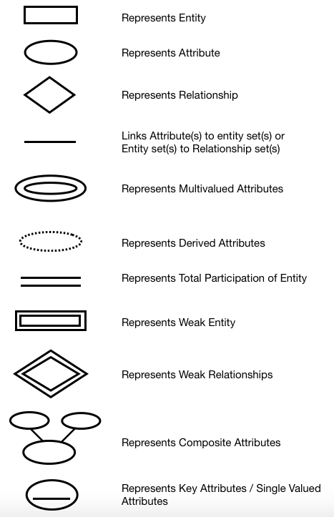

Slide 12
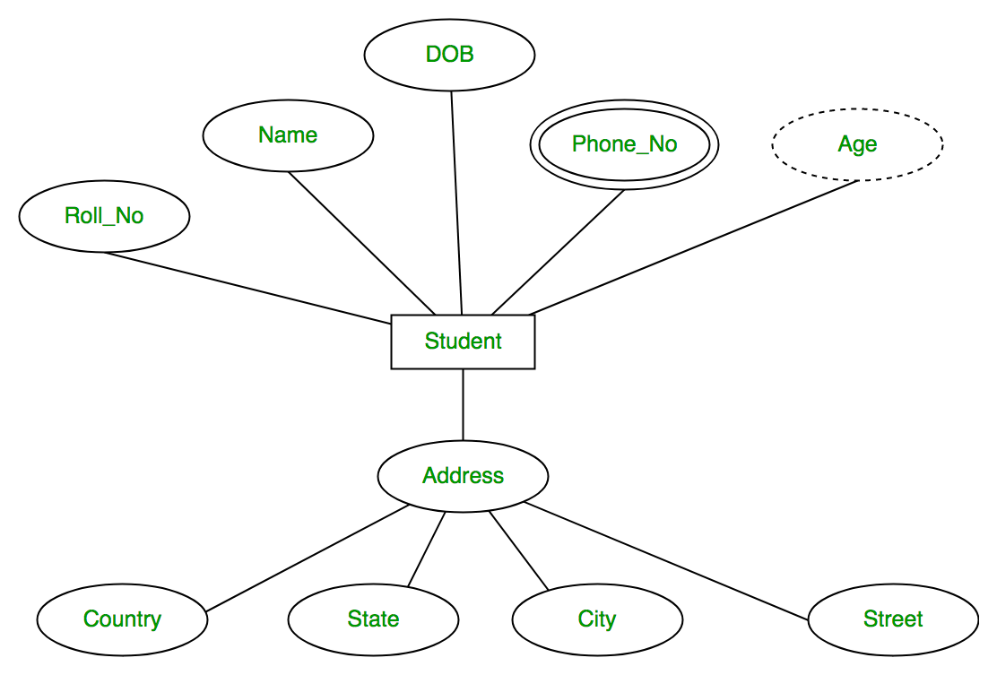

Slide 13
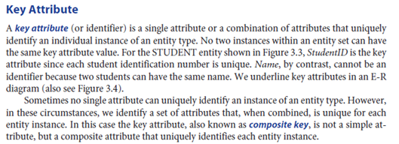

Slide 14
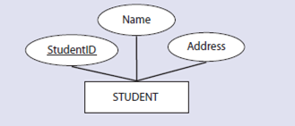

Slide 15
Attribute with NULL value
1. not appilcable
2.unknown

